Slide 1

Discovering Data Science
Andy White
SUID: 598554401

Slide 2
Program Learning Outcomes
Describe a broad overview of the major practice areas of data science.
Collect and organize data.
Identify patterns in data via visualization, statistical analysis, and data mining.
Develop alternative strategies based on the data.
Develop a plan of action to implement the business decisions derived from the analyses.
Demonstrate communication skills regarding data and its analysis for managers, IT professionals, programmers, statisticians, and other relevant professionals in their organization.
Synthesize the ethical dimensions of data science practice (e.g., privacy).

Slide 3
Introduction to R
IST 687 and Application

Slide 4
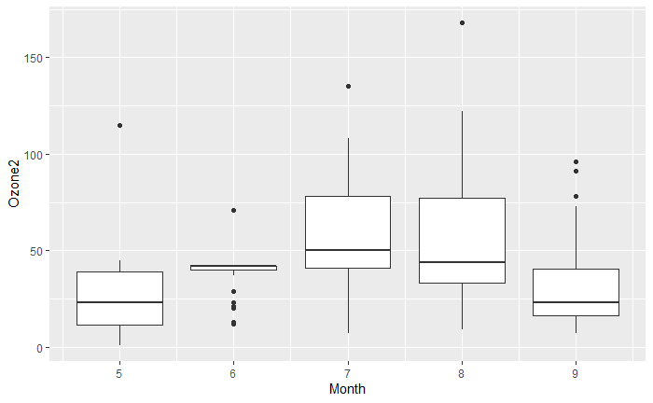
Introduction to GGPLOT
While simple, the graphic gave me an intro to the advanced visualization capabilities within in R.
Later I would discover the geospatial capabilities in GGPLOT, TMAP, and Leaflet libraries.

Slide 5
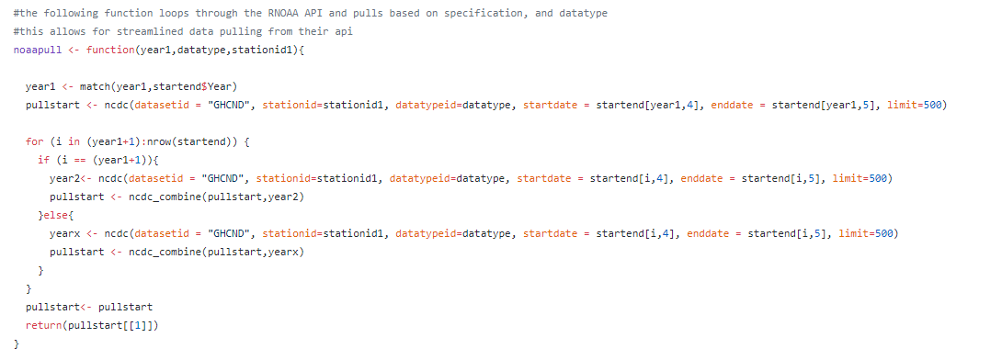
Finding a Solution to API Limits with a Loop
The loop above interacted with NOAA through their Rnoaa package. There were limitation on number of years and datatypes a user was able to pull.
The solution was to use a function with a for loop. With this loop, a user can significantly improve quantities of data pulled from NOAA.

Slide 6
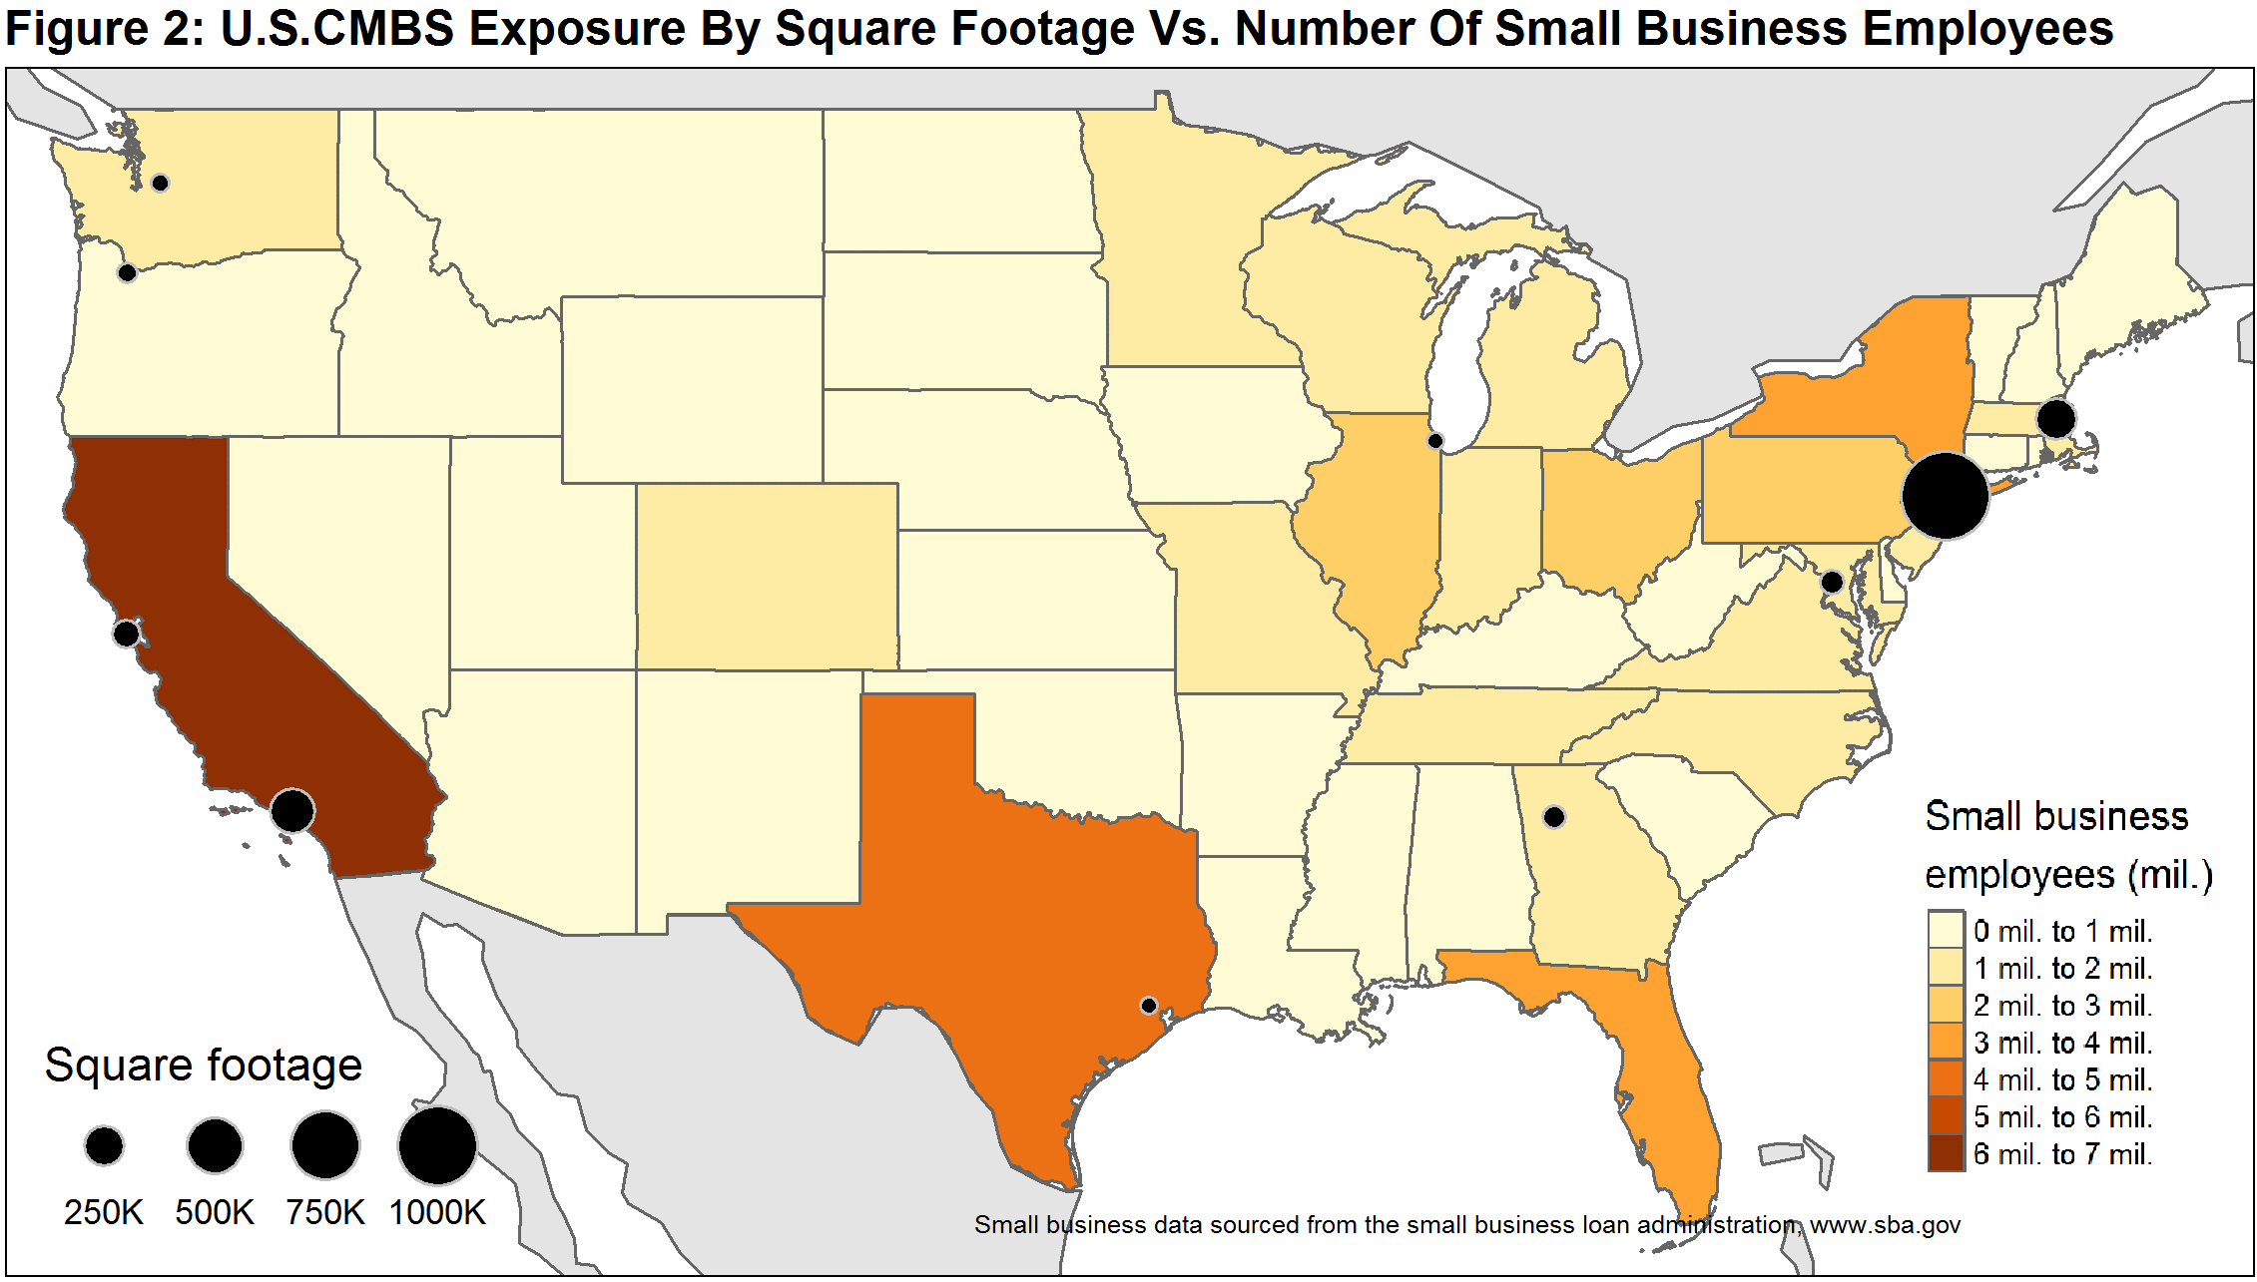
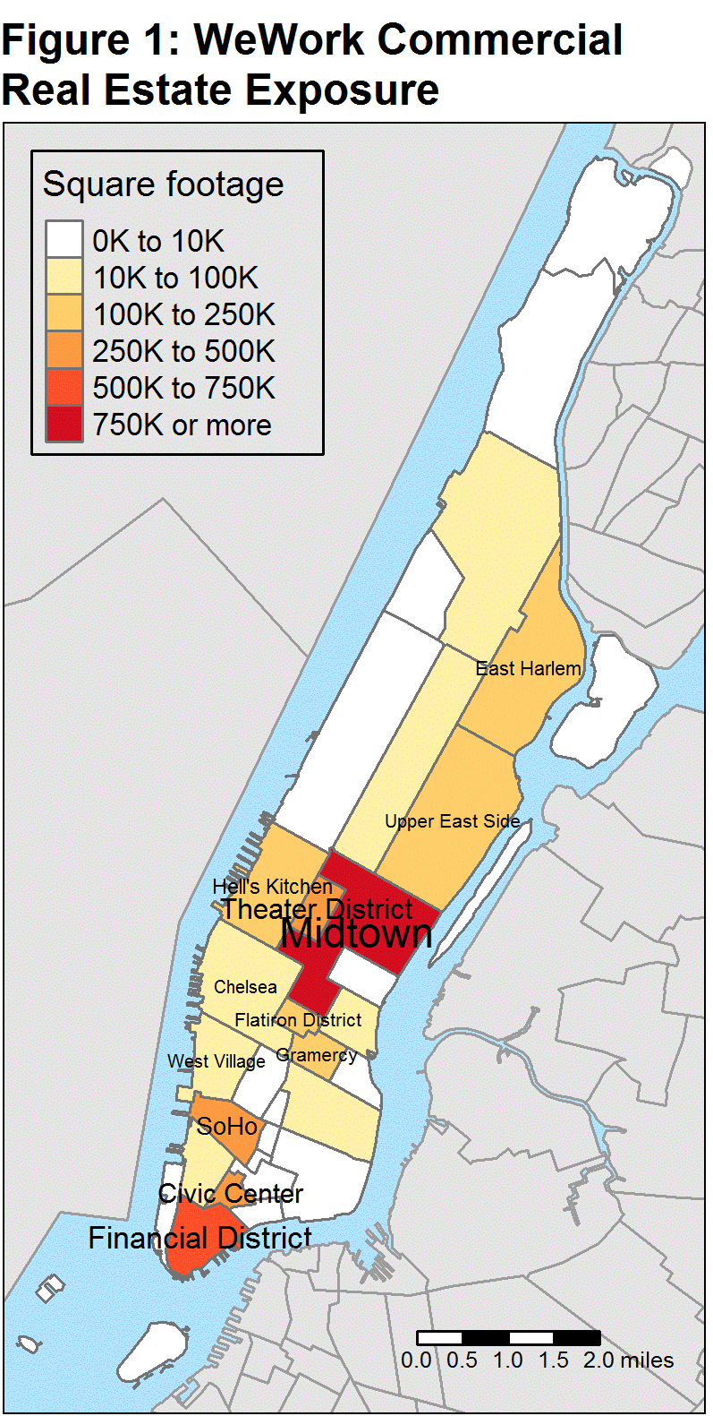
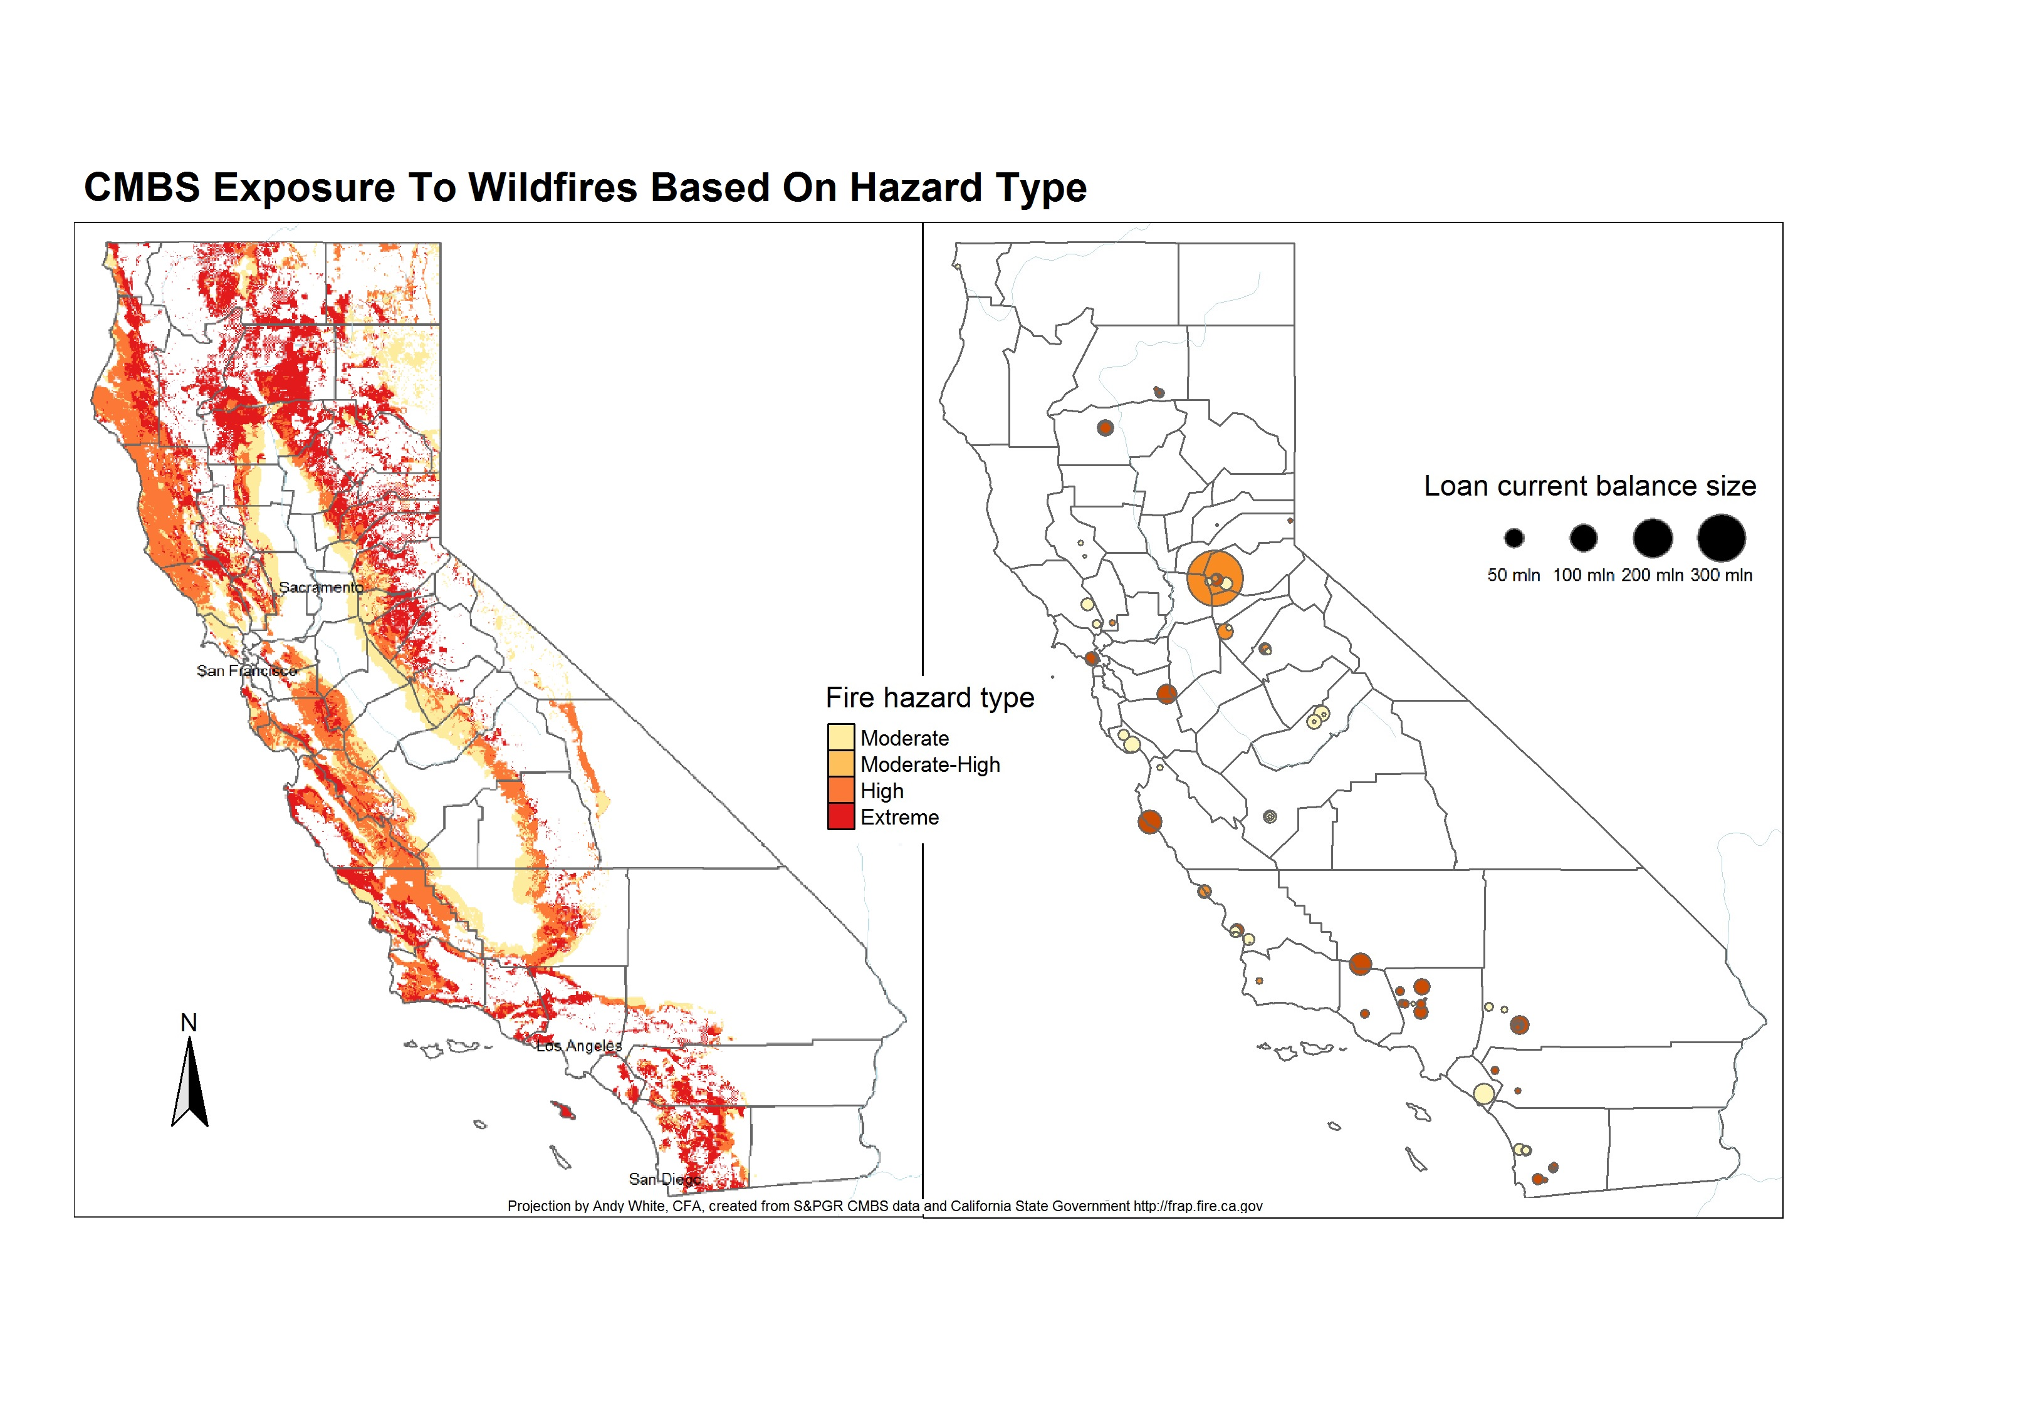
Application
Investors and clients were particularly interested in the visuals as they helped enhance a research commentary and an email blast. With the WeWork article winning a few awards.
Notes:
The article can be viewed here: https://github.com/andywhite7234/Syracuse_Work/blob/Real_world_impact/We_Work_Commentary.PDF
I create the maps with the following code:
https://github.com/andywhite7234/Syracuse_Work/blob/Real_world_impact/Maps.R
https://github.com/andywhite7234/Syracuse_Work/blob/Real_world_impact/Fire_prone.R

Slide 7
Introduction to Python and machine learning
IST 707, 654, and 736

Slide 8
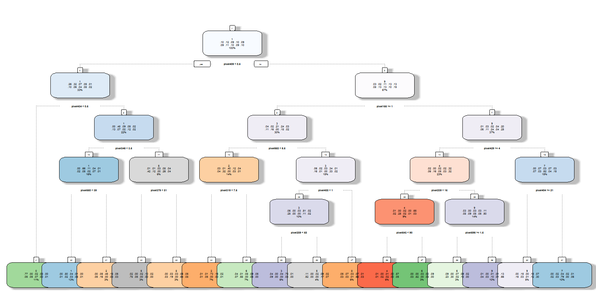
First Introduction to ML Algorithms
Decision Tree Classification
This classification tool was used for image classification
I liked that it was clear to see pixel values and probabilities.
Notes:
Code: https://github.com/andywhite7234/Syracuse_Work/blob/ML_Algos_in_R/HW_6.R
Write-up: https://github.com/andywhite7234/Syracuse_Work/blob/ML_Algos_in_R/Andy_White_HW06.docx

Slide 9
Using Unstructured Data For Prediction
Using the Tweepy package within python and beautiful soup, I was able to get access to a plethora of unstructured data.
From here a number of tokenization and count vectorization strategies were learned and implemented using standard built in functionality of the sklearn package.
IST 707 and IST 654 allowed me to hone unstructured pre-processing and pattern generation through numerous classification techniques.
These strategies were later used in several on-going work projects.

Slide 10
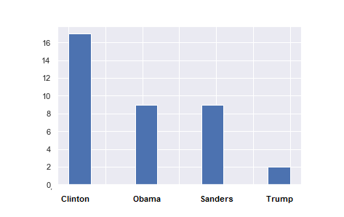
Using Twitter Data to Predict an Election
Using Naïve Bayes in the sklearn package, the idea was to classify as many tweets by President Biden to see if there were any similarities in word usage between Hillary Clinton in 2016, President Obama in 2012, Bernie Sanders in the 2016 Democratic Primary, and President Trump in the 2016 election.
Surprisingly, most of Biden’s tweets classified

Slide 11
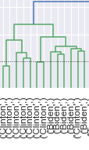
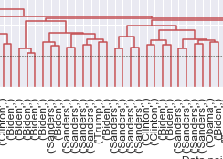
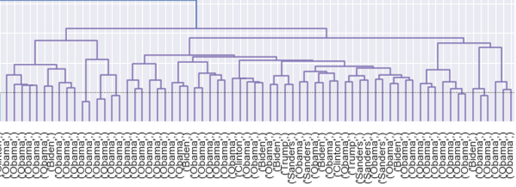
Clustering of Biden’s Tweets

Slide 12

Using a Class Project to Build Something Bigger
After the conclusion of the Text Mining course, I new it was time to build a strategy to put myself ahead in my career. All the pieces were in place, I just needed to build. Enter IST 654, the Natural Language Processing Course.

Slide 13

Goal 1:
Goal 2:
Use sentiment analysis to help structured finance look at market risk in a timely manner.
Use learnings from both Text Mining and NLP courses to build a solution the market has yet to see.
Goal 3:
Goal 4:
Produce findings to the market.
Use deep learning prediction techniques to build a “prediction companion” to go with strategy.

Slide 14
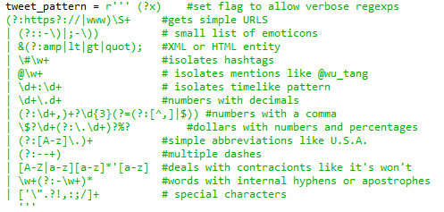
NLP and Building Laying Ground-Work For a Research Project
Pre-Processing in RegEx
Output of negative and Positive word drivers

Slide 15
Next steps

Slide 16
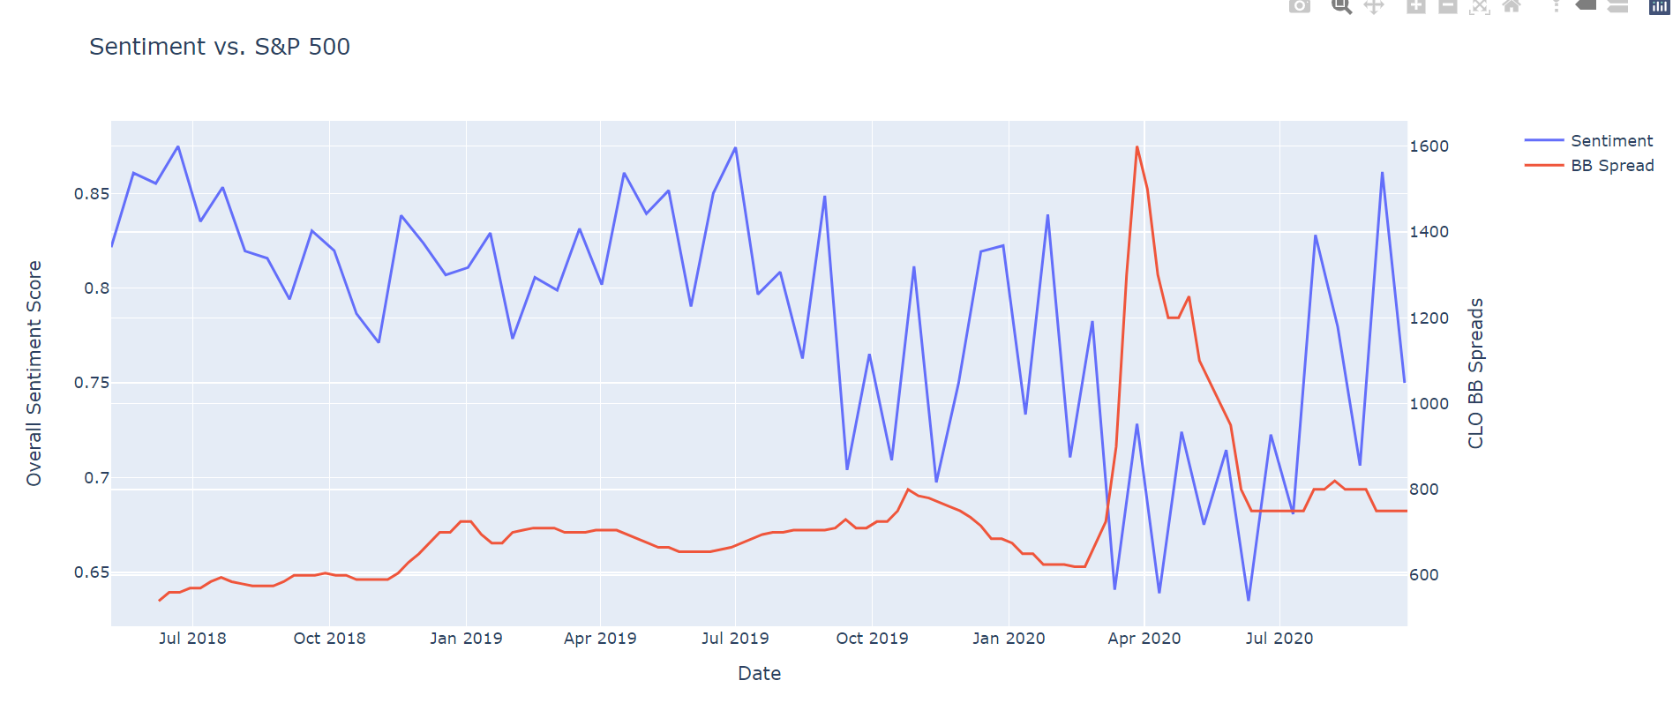
Structured Finance Sentiment
Using a number of packages I was able to pull approximately 20,000 tweets over the past two years to look at sentiment from structured finance related keywords.
From here, I classified approximately 2500 tweets as negative, neutral, or positive.
The accuracy score was around 72% using a bigram, term frequency inverse document frequency (TFIDF) strategy.

Slide 17
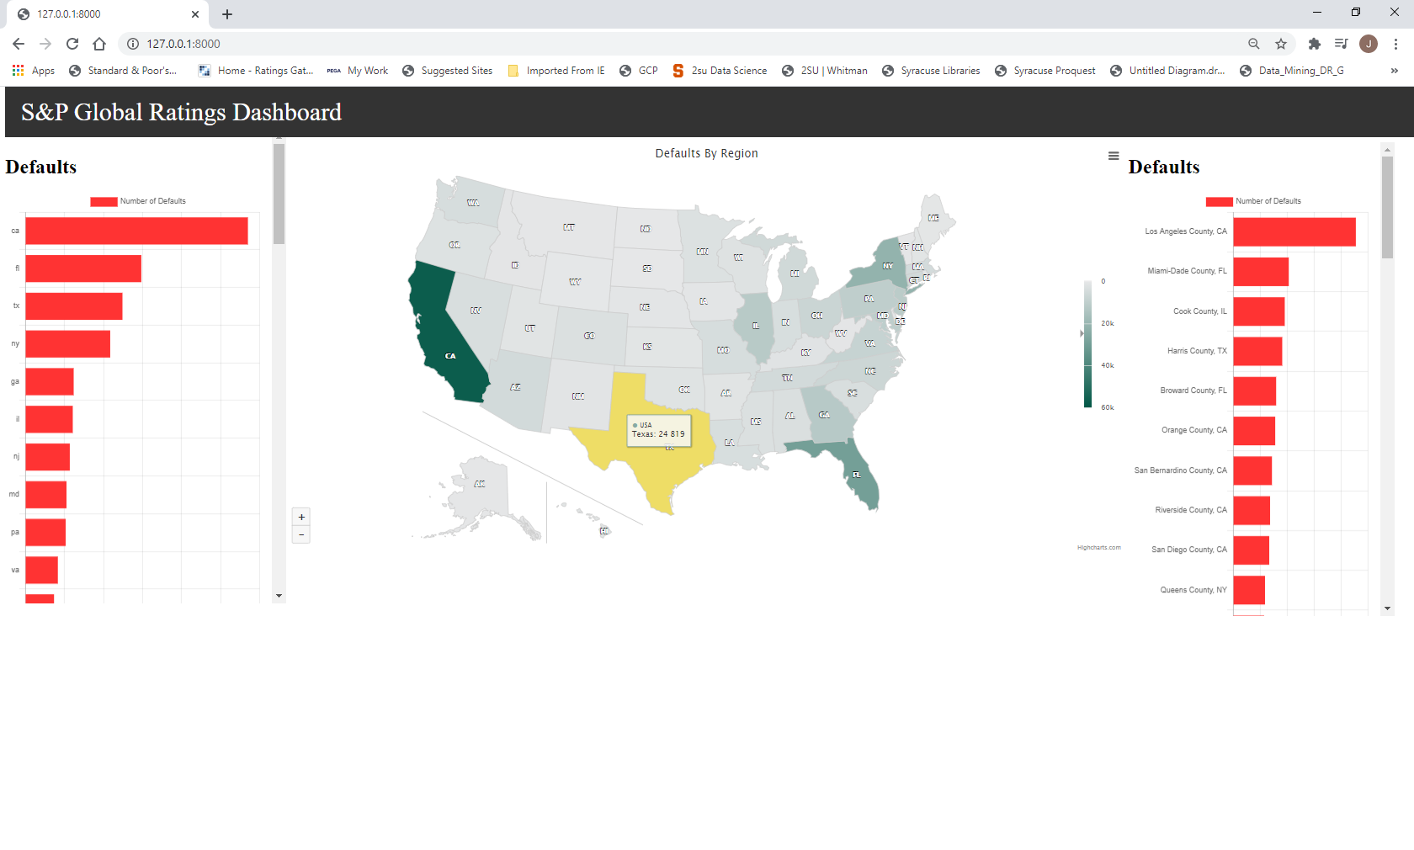
Bringing it All Together
The Dashboard uses Django (a python library) but the visuals are built in JavaScript, the data is pulled from several database tables, and data cleaning is completed in python.

Slide 18
Ethics – Helping Build Tomorrow’s Data Scientists
I have started a few classes through a local society (CFA Colorado) to volunteer my time and create a coding curriculum for the underprivileged. While COVID-19 Has put things on hold, I hope to continue to build on these opportunities.
The code for each class is elementary, but I believe it helps younger folks understand that the jump into coding is not as large as one expects. With proper guidance, a young person can learn anything and I hope to continue these learnings once we put the pandemic in the rear view.

Slide 19
Thank You

